Slide 1
GEOSPATIAL AI & ENVIRONMENTAL MACHINE LEARNING
Urban Heat Island
Predictive modeling of Land Surface Temperature (LST) using satellite telemetry and spatial AI.
github.com/tmthangaraj1980-AIML/Urban_Heat_Island

Slide 2

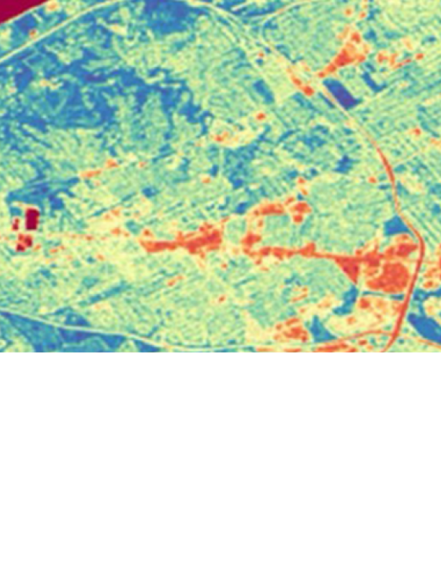
THE PROBLEM
Thermal Inequity
Microclimate Extremes: Dense concrete traps heat, raising localized temperatures.
Resource Strain: Exponential spikes in urban AC energy consumption.
Invisible Vulnerability: City planners lack high-resolution thermal mapping.

Slide 3



Solution Objectives
Earth Observation
Index Extraction
Spatial Prediction
Process Landsat/Sentinel multispectral imagery streams.
Calculate NDVI (Vegetation) and NDBI (Built-up) ratios.
Generate high-resolution predictive thermal heatmaps.

Slide 4






Geospatial Tech Stack
Python
Google Earth
Engine
GeoPandas
Rasterio
Scikit-Learn
Streamlit

Slide 5

Processing Architecture
Regression
Model
Satellite
Telemetry
Feature
Extraction
Interactive
LST Map

Slide 6
Geospatial Pipeline
1. Ingestion
2. Alignment
3. Engineering
4. Inference
Fetch Landsat 8 TIRS/OLI bands.
Cloud masking and CRS projection.
Compute NDVI, NDBI, and Albedo.
Predict spatial Land Surface Temp.

Slide 7
Data Sources & Key Vectors
Inputs
Derived Features
Landsat 8 Operational Land Imager.
NDVI: Normalized Difference Vegetation Index.
Thermal Infrared Sensor (TIRS) Band 10.
NDBI: Normalized Difference Built-up Index.
OpenStreetMap Building Footprints.
Albedo: Surface solar reflectance ratio.

Slide 8
Predictive Modeling
Regression Engine
Spatial Upsampling
Algorithm: Random Forest / XGBoost
Architecture: Convolutional Filter
Maps non-linear relationships between spectral indices (NDVI/NDBI) and ground truth temperature arrays.
Enhances 100m thermal band resolution using 30m multispectral bands for granular block-level mapping.

Slide 9
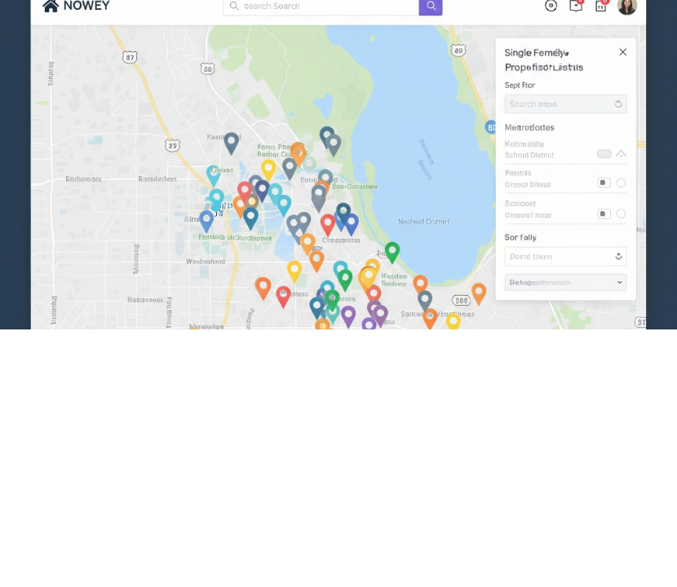
Interactive Dashboard
Folium and Streamlit integration projecting LST inference layers directly over interactive city basemaps.
Data Layer: Active

Slide 10
Results & Constraints
Model Performance
Technical Limitations
Optical occlusion from heavy cloud cover.
1.2°C
0.89
Low temporal resolution (16-day passes).
Root Mean Square Error
R-Squared Score
Missing micro-wind fluid dynamic factors.

Slide 11
Technical Q&A
1. How is LST derived physically?
4. Why use NDVI as a feature?
Converting Top of Atmosphere (TOA) spectral radiance to brightness temperature, then correcting for surface emissivity.
Vegetation transpires water, actively cooling surfaces; strong negative correlation with LST.
2. Role of Google Earth Engine?
5. Explain Spatial Autocorrelation?
Cloud-based API allowing petabyte-scale satellite raster computation without local downloads.
Tobler's First Law: near things are more related. Addressed by spatial cross-validation.
3. Handling CRS (Coordinate Reference System) mismatches?
Reprojecting all layers to a unified UTM zone using GeoPandas/Rasterio.

Slide 12

Mapping the Climate Micro-Front.
Empowering urban planners with high-fidelity thermal intelligence to deploy targeted green infrastructure.
/Urban_Heat_Island
tmthangaraj1980

Slide 13


Image Sources
https://earthdata.nasa.gov/s3fs-public/styles/hero_background_745/public/2025-09/ARSET-UrbanHeat-2022-hero.png?VersionId=MYHJ.pzw4CMKCitn1Vibbn5eWhz4nhIU&itok=08ffTUq4
Source: www.earthdata.nasa.gov
https://www.aeologic.com/images/interactive-web-map-for-real-estate-listings.png
Source: www.aeologic.com

